Slide 1
GLOBAL SUNFLOWER OIL
MARKET.
TURKISH AND NORTH AFRICAN SUNFLOWER OIL MARKETS.
OILSEEDS & OILS 2014
October 7, 2014, ​Barcelona/Spain
Sunseedman

Slide 2
STRUCTURE OF PRESENTATION
1-THE ROLE OF SUNOIL GLOBALLY
2 – TURKISH SUNOIL MARKET
3- NORTH AFRICAN SUNOIL MARKET
4 – 2014/2015 SEASON PROJECTIONS
5- PRESENTATION SUMMARY
Sunseedman

Slide 3
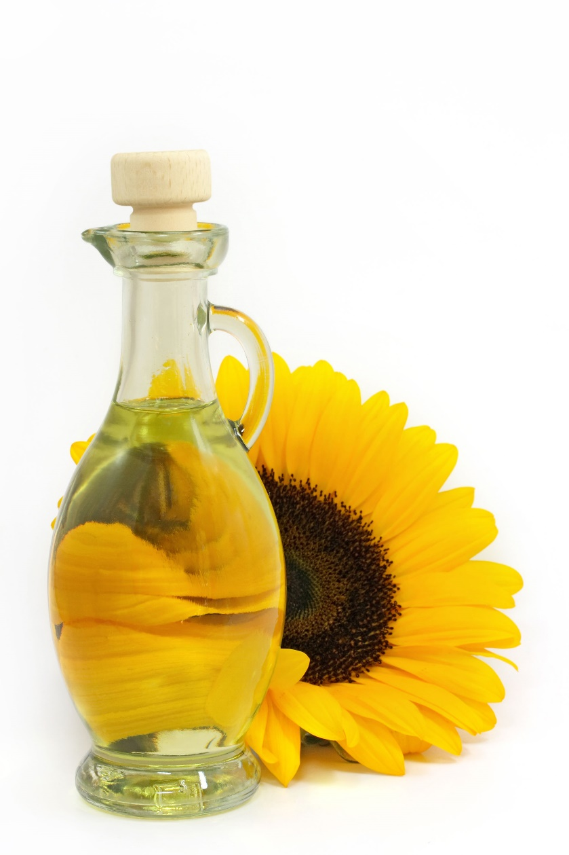
THE ROLE OF SUNOIL GLOBALLY
Sunseedman

Slide 4
IN 2013/14 SEASON;
WORLD VEGOIL PRODUCTIONS WERE AROUND
168 MLN T
SUNOIL WAS
THE 4TH BIGGEST VEGOIL FOLLOWING PALMOIL, SOYOIL AND RAPEOIL
WITH 9.6% ( 16.10 MLN T ) SHARE.
Sunseedman

Slide 5
WORLD VEGOILS PRODUCTION ( MLN MTON)
Source: OIL WORLD & USDA & SUNSEEDMAN
Sunseedman

Slide 6
IN 2013/14 SEASON;
WORLD VEGOIL EXPORTS WERE AROUND
71 MLN T
SUNOIL WAS
THE 3RD BIGGEST VEGOIL FOLLOWING PALMOIL AND SOYOIL
WITH 11.3% ( 7.99 MLN T ) SHARE.
Sunseedman

Slide 7
WORLD VEGOILS EXPORTS ( MLN MTON)
Source: OIL WORLD & USDA & SUNSEEDMAN
Sunseedman

Slide 8
TOTTING UP;
SUNFLOWER OIL IS ONE OF THE MOST PRODUCED AND TRADED VEGOILS OF THE WORLD.
Sunseedman

Slide 9
WITH HUGE INVESTMENTS WITH NEW-MILLENIUM;
UKRAINE ( 4.6 MLN T ) AND RUSSIA ( 4.06 MLN T ) TOGETHER PERFORM MORE THAN HALF ( 54% ) WORLD SUNOIL PRODUCTION
( 16.10 MLN T )
Sunseedman

Slide 10
WORLD SUNOIL PRODUCERS ( THD T )
Source: OIL WORLD & SUNSEEDMAN
Sunseedman

Slide 11
UKRAINE
( 4.1 MLN T )
ONLY PERFORMS MORE THAN HALF
( 51% ) OF THE WORLD SUNOIL EXPORTS
( 7.99 MLN T )
Sunseedman

Slide 12
WORLD SUNOIL EXPORTERS ( THD T )
Source: OIL WORLD & SUNSEEDMAN
Sunseedman

Slide 13
INDIA IS THE BIGGEST SUNOIL IMPORTER COUNTRY
( 1.53 MLN T )
AND
ONLY PERFORMS
19% OF THE WORLD SUNOIL IMPORTS
( 8.13 MLN T )
Sunseedman

Slide 14
WORLD SUNOIL IMPORTERS ( THD T )
Source: OIL WORLD & SUNSEEDMAN
Sunseedman

Slide 15
NOW LET’S LOOK AT GLOBAL SUNOIL MARKET PRICES;
ROTTERDAM, BLACK SEA AND ARGENTINA ( INDEED STARTED TO BE SURPLUS RECENTLY ) SUNOIL MARKET PRICES ARE FOLLOWED.
Sunseedman

Slide 16
AS PER OUR OIL WORLD DATABASE;
WE HAVE MARKET PRICES SINCE 1988/1989 SEASON FOR MOST OF VEGOILS INCLUDING SUNOIL.
BLACK SEA SUNOIL PRICES ARE AVAILABLE ONLY WITH NEW MILLENIUM.
Sunseedman

Slide 17
FIRST, LET’S LOOK AT CRUDE SUNOIL FOB PRICES AS PER ROTTERDAM ( 6 PORTS ), ARGENTINA AND BLACK SEA SINCE 1988/1999 SEASON
Sunseedman

Slide 18
Source: OIL WORLD & SUNSEEDMAN
Sunseedman

Slide 19
AS YOU SEE;
1999/2000 SEASON IS THE BOTTOM WITH 352 AND 413 $/MT FOR ARGENTINA AND ROTTERDAM RESPECTIVELY.
IN OCT 2000, ARGIE AND ROTTERDAM FOB PRICES WERE EVEN 294 AND 340 $/MT RESPECTIVELY.
Sunseedman

Slide 20
AS YOU SEE ALSO;
2007/2008 SEASON IS THE PEAK WITH 1.499, 1.501 AND 1.639 $/MT FOR BLACK SEA, ARGENTINA AND ROTTERDAM RESPECTIVELY.
IN JUNE 2008, BLACK SEA, ARGIE AND ROTTERDAM FOB PRICES WERE EVEN 1.774, 1.849 AND 2.045 $/MT RESPECTIVELY.
Sunseedman

Slide 21
SECOND, LET’S LOOK AT CRUDE SUNOIL FOB BLACK SEA PRICES SINCE 2000/2001 SEASON WHEN UKRAINE STARTED TO BE ONE OF THE MAJOR EXPORTERS.
Sunseedman

Slide 22
Source: OIL WORLD & SUNSEEDMAN
Sunseedman

Slide 23
AS YOU SEE;
2000/2001 SEASON WAS THE BOTTOM WITH 382 $/MT.
IN OCT 2000, 299 $/MT OF THE LOWEST MONTHLY LEVEL WAS SEEN.
IN JUNE 2008, 1.774 $/MT OF THE HIGHEST MONTHLY LEVEL WAS SEEN.
HOWEVER, WE EVEN EXPERIENCED
AROUND 1.900 $/MT BY MID-JUNE 2008.
Sunseedman

Slide 24
NOW, LET’S LOOK AT ROTTERDAM SUNOIL AND OTHER VEGOILS PRICES SINCE 1988/1999 SEASON
Sunseedman

Slide 25
Source: OIL WORLD & SUNSEEDMAN
Sunseedman

Slide 26
EXCEPT SOME EXTREME SEASONS, ROTTERDAM SUNOIL WAS ALMOST THE MOST HIGH-PRICED VEGOIL.
Sunseedman

Slide 27
TURKISH SUNOIL OUTLOOK
Sunseedman

Slide 28
TURKISH LIQUID VEGOILS CONSUMPTION ( 1000 TONS )
Source: SUNSEEDMAN
Sunseedman

Slide 29
TURKISH VEGOILS IMPORTS ( 1000 TONS )
Source: SUNSEEDMAN & TURKSTAT
Sunseedman

Slide 30
TURKISH VEGOILS EXPORTS ( 1000 TONS )
Source: SUNSEEDMAN & TURKSTAT
Sunseedman

Slide 31
SUNOIL IS THE BIGGEST CONSUMED, EXPORTED AND IMPORTED VEGOIL OF TURKEY.
Sunseedman

Slide 32
Source: OIL WORLD & SUNSEEDMAN
Sunseedman

Slide 33
Source: OIL WORLD & SUNSEEDMAN
Sunseedman

Slide 34
Source: OIL WORLD & SUNSEEDMAN
Sunseedman

Slide 35
AS YOU SEE;
TURKEY IS ONE OF THE BIGGEST PLAYERS IN WORLD
SUNOIL PRODUCTION AND TRADE
Sunseedman

Slide 36
NOW, LET’S LOOK AT ALSO TURKISH CRUDE SUNOIL LOCAL AND CIF PRICES SINCE JANUARY 2008
Sunseedman

Slide 37
TURKISH LOCAL CRUDE SUNOIL PRICES ( TL/MT )
Source: SUNSEEDMAN
Sunseedman

Slide 38
BY MID-MARCH 2014,
LOCAL PRICES REACHED THE PEAK WITH 3.175 TL/MT
AND
BY EARLY OCTOBER 2009, LOCAL PRICES BOTTOMED OUT WITH 1.625 TL/MT
Sunseedman

Slide 39
TURKISH CRUDE SUNOIL CIF PRICES ( $/MT )
Source: SUNSEEDMAN
Sunseedman

Slide 40
BY MID-JUNE 2008,
CIF PRICES REACHED THE PEAK WITH 1.940 $/MT
AND
BY EARLY JANUARY 2009, CIF PRICES BOTTOMED OUT WITH 640 $/MT
Sunseedman

Slide 41
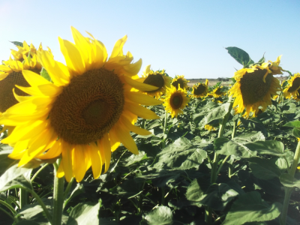
NORTH AFRICAN SUNOIL OUTLOOK
Sunseedman

Slide 42
NORTH AFRICAN COUNTRIES
( EGYPT, ALGERIA, MOROCCO AND LIBYA ) ARE ONE OF MAJOR DESTINATIONS OF SUNOIL EXPORTS
Sunseedman

Slide 43
NORTH AFRICAN SUNOIL IMPORTS ( THD T )
Source: OIL WORLD
Sunseedman

Slide 44
Source: OIL WORLD
Sunseedman

Slide 45
AS YOU SEE;
EGYPT IS MAIN DESTINATION COUNTRY OF NORTH AFRICA WITH MORE THAN 80%
( 751 KMT OF TOTAL 915 KMT ) SHARE.
Sunseedman

Slide 46
EGYPTIAN VEGOILS TENDERS
( LAUNCHED BY PUBLIC FIHC & MEDITRADE, INDEED THE LATTER IS OUT OF ORDER NOW )
ARE ONE OF THE
MAIN SUNOIL PRICE INDICATORS IN WORLD MARKETS.
Sunseedman

Slide 47
VIA TENDERS ;
IN 2011; 438 KMT OF SFO & 570 KMT OF SBO,
IN 2012; 809 KMT OF SFO & 350 KMT OF SBO,
IN 2013; 504 KMT OF SFO & 361.5 KMT OF SBO,
IN 2014 SO FAR;
375.5 KMT OF SFO & 159 KMT OF SBO
WERE PURCHASED.
Sunseedman

Slide 48
Source: SUNSEEDMAN
Sunseedman

Slide 49
IN THE LAST TENDER OF
1st OCTOBER 2014;
IN SPITE OF 40 KMT PROJECTED,
ONLY 12 KMT OF SUNOIL WERE PURCHASED DUE TO UNIQUE PARTICIPATION OF ADM.
OTHERS AVOIDED WITH L/C OPENING TROUBLES.
Sunseedman

Slide 50
2014/15 SEASON PROJECTIONS
Sunseedman

Slide 51
WORLD SUNOIL PRODUCTION 15.5 MLN T VS 16.10 MLN T OF 2013/14
WORLD SUNOIL EXPORTS
7.4 MLN T VS 7.99 MLN T OF 2013/14
WORLD SUNOIL IMPORTS
7.5 MLN T VS 8.13 MLN T OF 2013/14
Sunseedman

Slide 52
TURKISH SUNOIL PRODUCTION
900 KMT VS 860 KMT OF 2013/14
TURKISH SUNOIL EXPORTS
600 KMT VS 685 KMT OF 2013/14
TURKISH SUNOIL IMPORTS
700 KMT VS 795 KMT OF 2013/14
NORTH AFRICAN SUNOIL IMPORTS
800 KMT VS 915 KMT OF 2013/14
Sunseedman

Slide 53
DISLIKE SOYOIL SURPLUS,
SUNOIL PRODUCTION WILL HAVE SHORTAGE
THUS, SUNOIL PRICES MAY HAVE SOME 25 - 50 $/MT PREMIUM
( ESPECIALLY IN THE SECOND HALF 2014/15 SEASON ) VS SOYOIL PRICES.
Sunseedman

Slide 54
PRESENTATION
SUMMARY
Sunseedman

Slide 55
SUNFLOWER IS ONE OF THE MOST PRODUCED AND TRADED VEGOILS OF THE WORLD.
UKRAINE ONLY PERFORMS MORE THAN HALF OF THE WORLD SUNOIL EXPORTS.
INDIA IS THE BIGGEST SUNOIL IMPORTER COUNTRY.
EXCEPT SOME EXTREME SEASONS, ROTTERDAM SUNOIL WAS ALMOST THE MOST HIGH-PRICED VEGOIL.
SUNOIL IS THE BIGGEST CONSUMED, EXPORTED AND IMPORTED VEGOIL OF TURKEY.
TURKEY IS ONE OF THE BIGGEST PLAYERS IN WORLD SUNOIL PRODUCTION AND TRADE.
EGYPT IS MAIN SUNOIL EXPORT DESTINATION COUNTRY OF NORTH AFRICA.
EGYPTIAN VEGOILS TENDERS ARE ONE OF THE MAIN SUNOIL PRICE INDICATORS IN WORLD MARKETS.
DISLIKE SOYOIL SURPLUS, SUNOIL PRODUCTION WILL HAVE SHORTAGE THUS, SUNOIL PRICES MAY HAVE SOME 25 - 50 $/MT PREMIUM ( ESPECIALLY IN THE SECOND HALF 2014/15 SEASON ) VS SOYOIL PRICES.
Sunseedman

Slide 56
Great thanks
Muchas Gracias
Sunseedman

Slide 57
Sunseedman
VEYSEL KAYA
http://www.sunseedman.com
veyselkaya@sunseedman.com SKYPE : SUNSEEDMAN
GSM : 00 90 542 273 50 63 Facebook : http://www.facebook.com/SUNSEEDMAN
Linkedin : http://www.linkedin.com/in/SUNSEEDMAN
Twitter : http://www.twitter.com/SUNSEEDMAN

